Slide 1
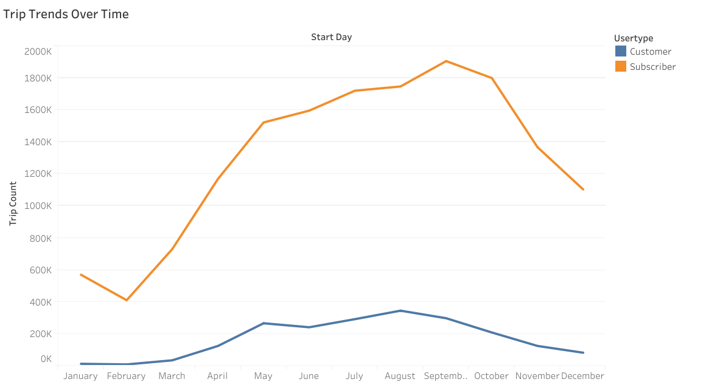
Cyclistic Bike Share Project Executive Summary
Overview
This project aims to improve understanding of Citi Bike usage in New York City to guide station planning, operational decisions, and marketing strategies.
The Problem
Cyclistic needs to better understand ridership patterns to optimize resources and expansion. Key challenges include:
Identifying high-traffic stations and underserved neighborhoods.
Understanding differences in usage patterns between subscribers and casual riders.
Accounting for external factors like weather that affect ridership.
The Solution
The team aggregated trip data and incorporated weather data. An interactive Tableau dashboard was built to visualize trip trends, station demand, and user behavior, with filters , enabling stakeholders to explore insights dynamically.
Details
Keys to success
Accurate integration of multiple datasets, including trip-level and aggregated data.
Clear and intuitive dashboard design to provide actionable insights for stakeholders.
Interactivity and filtering, allowing stakeholders to explore trends.
Data-driven decision making for marketing strategies, station expansion, and operational efficiency.
Monthly Trips Trend by User Type
Results Summary
The Cyclistic dashboard provides insights into bike usage patterns, highlighting high-demand stations, neighborhood trends, and differences between subscribers and casual riders. It also shows how weather impacts ridership.
Reflections/
Next Steps
The dashboard has improved stakeholder understanding of ridership patterns and informs marketing and operational decisions.
Future work includes incorporating real-time data for predictive analytics and optimizing station placement using demand modeling.
The project serves as a reference for similar bike-sharing initiatives in other cities.
As data collection and model refinement continue, Cyclistic expects to further enhance customer experience, reduce wait times, and increase ridership satisfaction.

